Slide 1










Using normalization rules to create local extension fields for a member institution of a consortium
Yoel Kortick. Senior Librarian
http://www.julac.org/

Slide 2
Agenda
1
Introduction
2
Using a normalization rule to add a local field

Slide 3
Introduction
When a record is shared with the network institution it is possible from the member institution to add a local field.
This local field will appear when viewing the record from the member institution but will not appear when viewing the record from the network institution

Slide 4
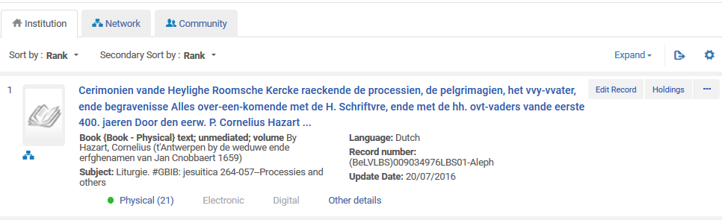
Introduction
For example here is title ‘Cerimonien vande Heylighe Roomsche Kercke raeckende de processien …’ (7801380) which is shared with the network institution
We are searching the institution
The record is shared with the network

Slide 5
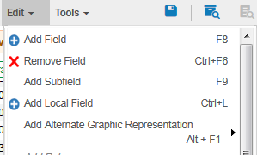
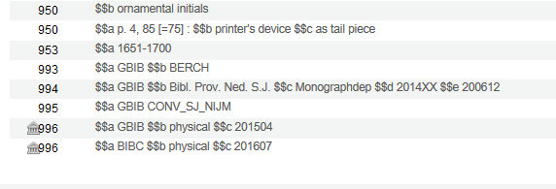
Introduction
In the Metadata Editor we see that this record has a 996 field with an icon (house) next to it indicating that it is a local field. It was added as a local field.
This function will add the field as a “local field” to a record which is shared with the network
Icon of a house indicating that this field is unique to the member institution

Slide 6
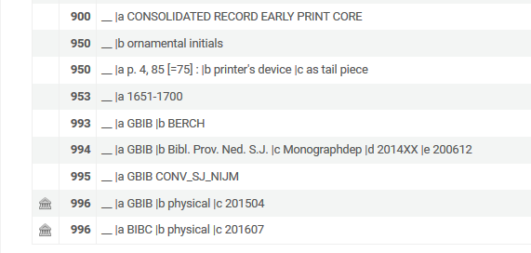
Introduction
The local field also appears in the ‘Marc Record Simple View’ (visible from the repository search results after clicking the title) while in the member institution

Slide 7
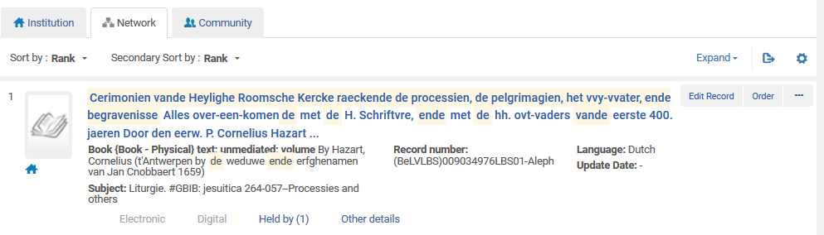
Introduction
Now we perform the same search via the ‘Network’ tab to see how the record appears in the network
This time we search the Network

Slide 8
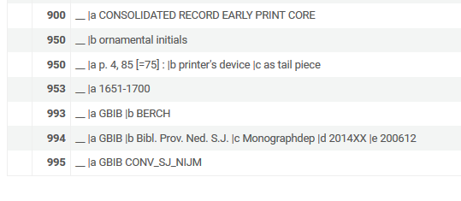
Introduction
Now after clicking the title in the network we do not see the local field
No 996 local field because we searched the network

Slide 9
Introduction
Here is a comparison of the same record in the member institution and in the network
Member institution with local field
Network without local field

Slide 10
Agenda
1
Introduction
2
Using a normalization rule to add a local field

Slide 11
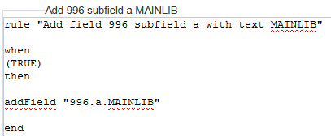
Using a normalization rule to add a local field
Typically a normalization rule to add a 996 would like this

Slide 12
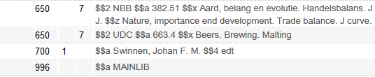
Using a normalization rule to add a local field
And the typical normalization rule would add a 996 like this

Slide 13
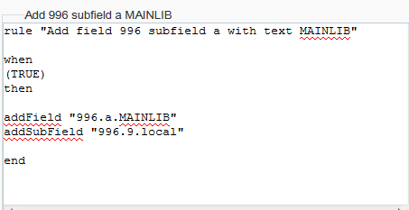
Using a normalization rule to add a local field
If we want the normalization rule to add the field as a local field then it needs to also have a subfield 9 with text ‘local’
Here is an example. It is like the previous example but this time the field will be added as local.

Slide 14
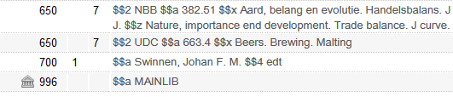
Using a normalization rule to add a local field
Now we can see that the normalization rule will add the field as a local field
When the normalization rule adds a subfield 9 then the field gets added as a local field

Slide 15
Using a normalization rule to add a local field
In summary:
If you want to use a normalization rule to add a local field of a member institution then you should add the field with a subfield 9 which has text ‘local’
This can be done (in the case of field 996) with the following command
addSubField "996.9.local"

Slide 16
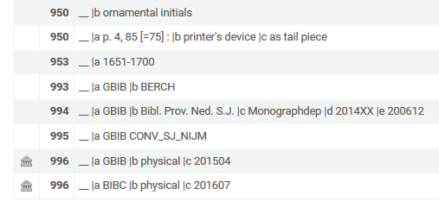
Using a normalization rule to add a local field
The example we showed here has the local field:
996 $$a BIBC $$b physical $$c 201607

Slide 17
Using a normalization rule to add a local field
Let’s say now we want to add:
996 $$a YILIS $$b YLK $$c Dimona $$9 local
A rule to add this would be as follows:
rule "Add field 996 and make it be a local extension"
when
( not exists "996.a.YILIS" )
then
addField "996.a.YILIS"
addSubField "996.b.YLK" if ( exists "996.a.YILIS" )
addSubField "996.c.Dimona" if ( exists "996.a.YILIS" )
addSubField "996.9.local" if ( exists "996.a.YILIS" )
end

Slide 18
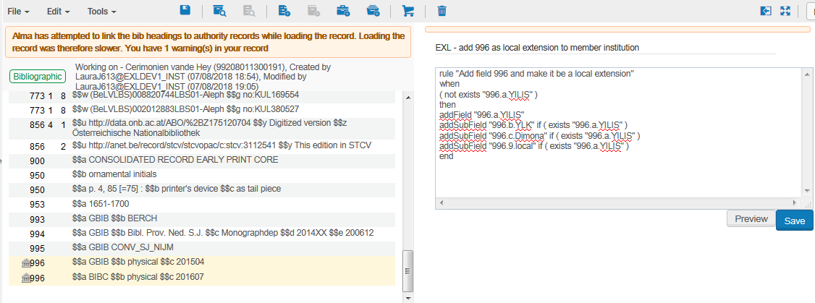
Using a normalization rule to add a local field
Here is the situation before testing the rule

Slide 19
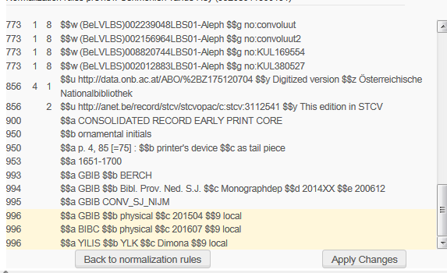
Using a normalization rule to add a local field
Here is the situation after testing the rule

Slide 20
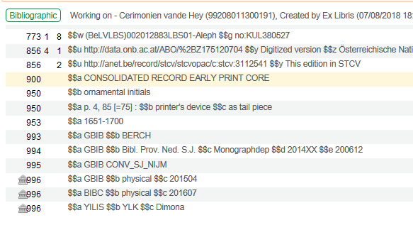
Using a normalization rule to add a local field
Here is the situation after applying the changes

